Slide 1
What Is The Grammar Of Graphics?
GGPLOT

Slide 2
The basic idea: independently specify plot building blocks and combine them to create just about any kind of graphical display you want. Building blocks of a graph include:
data
aesthetic mapping
geometric object
statistical transformations
scales
coordinate system
position adjustments
faceting

Slide 3
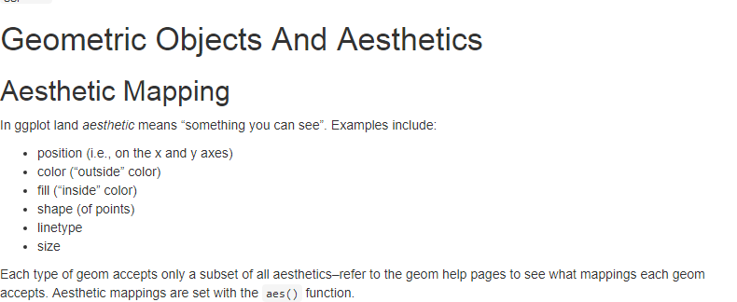

Slide 4
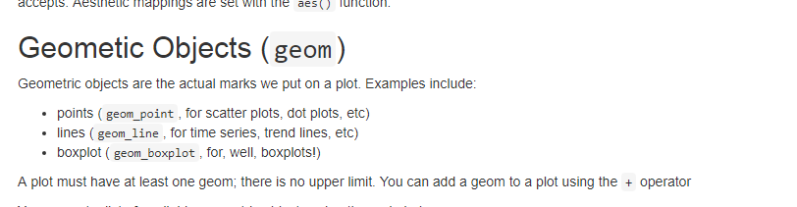
help.search("geom_", package = "ggplot2")

Slide 5
scatter
hp2001Q1 <- subset(housing, Date == 2001.25) ggplot(hp2001Q1, aes(y = Structure.Cost, x = Land.Value)) + geom_point()

Slide 6
hp2001Q1$pred.SC <- predict(lm(Structure.Cost ~ log(Land.Value), data = hp2001Q1)) p1 <- ggplot(hp2001Q1, aes(x = log(Land.Value), y = Structure.Cost)) p1 + geom_point(aes(color = Home.Value)) + geom_line(aes(y = pred.SC))

Slide 7
Statistical Transformation
housing.sum <- aggregate(housing["Home.Value"], housing["State"], FUN=mean) rbind(head(housing.sum), tail(housing.sum))

Slide 8
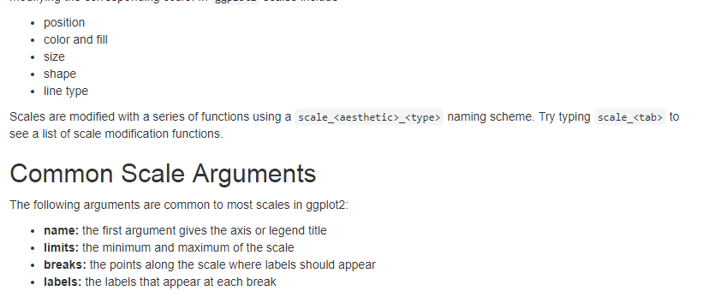
Scales: Controlling Aesthetic Mapping

Slide 9
Faceting
Faceting is ggplot2 parlance for small multiples
The idea is to create separate graphs for subsets of data

Slide 10
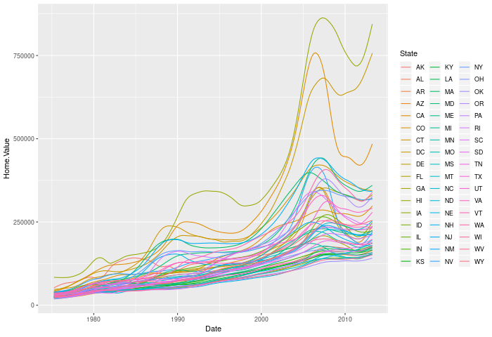
Faceting before

Slide 11
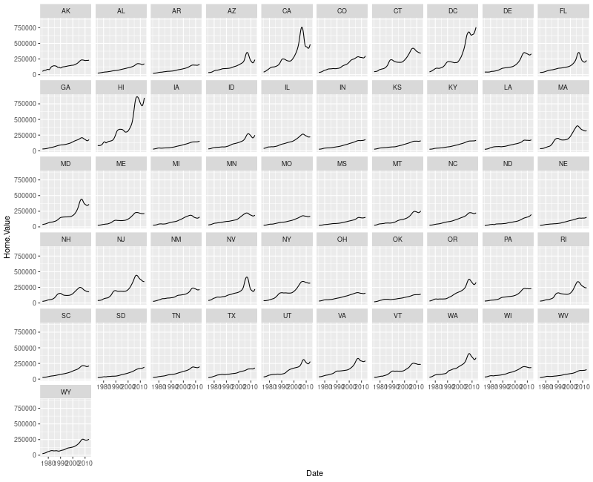
Faceting

Slide 12
